Slide 1
Appropriate Urinary Catheter Use and Management
Nursing Education Material
Mohamad Fakih, MD, MPH
Notes:
Promptly Remove Unnecessary Urinary Catheters
In the following presentation we will review Catheter Associated Urinary Tract Infections and the prevalence they have in the hospital setting today.
The goal of this module is to reinforce proper indications for urinary catheter placement, and to incorporate interventions to eliminate unnecessary use.
These objectives will in turn reduce the risk of Hospital acquired urinary tract infections.

Slide 2
This presentation
This presentation targets all nurses with patient care responsibilities including the unit manager and the clinical nurse leader of the unit involved. A test to evaluate knowledge post-presentation is also available.

Slide 3
Outline
The urinary catheter
Urinary catheter utilization
Catheter-associated urinary tract infection
Indications for urinary catheter utilization
Non-indications for urinary catheter utilization
Insertion and Maintenance of urinary catheters

Slide 4
Urinary Catheter
Developed in the 1920s by Dr. Frederick Foley
The urinary catheter was originally an open system with the urethral tube draining into an open container.
In the 1950s, a closed system was developed in which the urine flowed through a catheter into a closed bag.
Notes:
Promptly Remove Unnecessary Urinary Catheters
The urinary catheter drainage system was first developed in the 1920’s. Initially, the drainage system was open and the urine drained through a tube directly into an open container. Virtually 100% of the patients with this type of indwelling catheter in place for 4 or more days developed an infection.
However, in the 1950’s the closed drainage system was made available. Although adoption of the closed system has markedly reduced the risk of acquiring a catheter-associated infection, the risk is still substantial.

Slide 5
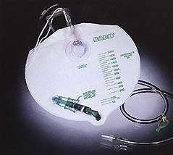
Closed System Urinary Catheter
Notes:
Promptly Remove Unnecessary Urinary Catheters
This is a sample of the Closed System Foley Catheter. The drainage tube is directly connected to the drainage bag.

Slide 6
Urinary Catheter Utilization
About 25% of patients during their hospitalization
Almost all of them are placed the same admission
A large number is placed in ED
Intensive care → medical-surgical units

Slide 7
Urinary Catheter Prevalence
On medical-surgical units: 10-30%
Intensive care units: 60-90%
Gokula, Am J Infect Control 2004;32:196-9
Apisarnthanarak, Am J Infect Control 2007;35:594-9
Edwards, Am J Infect Control 2007;35:290-301

Slide 8
Urinary Catheter Utilization
About 15-25% of patients during their hospitalization will have an urinary catheter placed
Many are placed either in the intensive care or Emergency Department
40% - 50% of these patients do not have a valid indication for urinary catheter placement
Notes:
Promptly Remove Unnecessary Urinary Catheters
About 25% of patients will have a Foley catheter during their hospitalization. A large number of these are placed in the emergency department or the intensive care units. Approximately half of these catheters placed do not have a valid indication.

Slide 9
Urinary catheters are not harmless…
Urinary tract infection
Mechanical trauma to urethra and bladder
Immobility (restraining patient)*
Prolonged stay?
Pressure Ulcers?
Falls?
*Saint S, Ann Intern Med 2002; 137: 125-7

Slide 10
Hospital-Acquired UTI: Prevalence
600,000 patients develop hospital-acquired UTI’s per year
Catheter-associated infections (CAUTI) comprise 80% of these cases
UTIs account for 40% of all hospital-acquired infections
Notes:
Promptly Remove Unnecessary Urinary Catheters
UTIs account for about 40% of the total number of hospital acquired infections, affecting an estimated 600,000 patients per year. 80% of these UTI’s are catheter-associated.
Although not all catheter-associated urinary tract infections can be prevented, it is believed that a large number could be avoided by the proper management of the indwelling catheter specifically discontinuing unnecessary catheters.

Slide 11
Catheter Associated UTI (CAUTI)
Catheter-risk of bacteriuria increases each day of use:
  Per day: 5%
  1 week: 25%
  1 month: 100%
Notes:
Promptly Remove Unnecessary Urinary Catheters
Let’s examine the rates of catheter associated urinary tract infections.
Studies have shown the occurrence of bacteriuria in patients with urinary drainage system increases approximately 5% each day the catheter is in place. After one week the risk increases to 25%; and after one month with a urinary catheter 100% of the patients will have bacteriuria.
Although catheter-associated UTIs historically have been associated with low morbidity and mortality, they may increase patient hospital length of stay, increase exposure to antibiotics the risk for developing antibiotic-resistant organisms

Slide 12
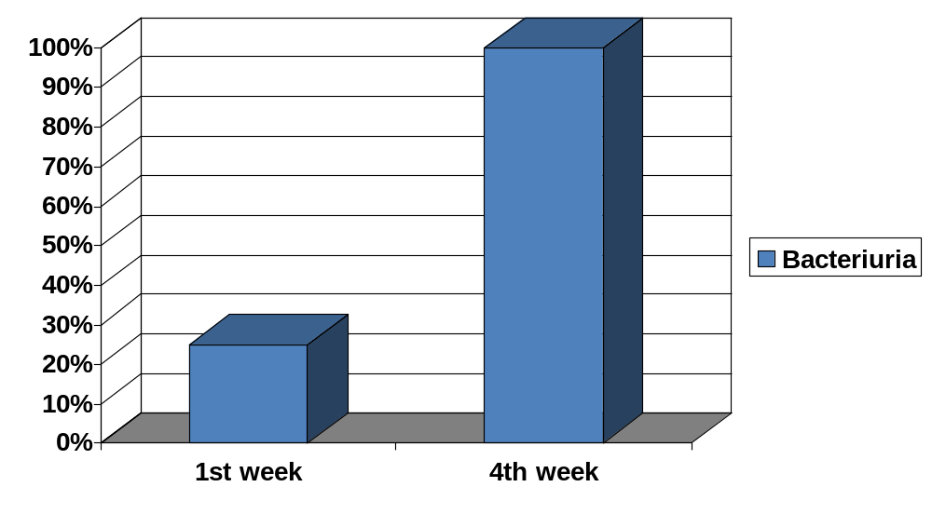
Catheter-Associated Bacteriuria
(Closed Drainage System)
Notes:
Promptly Remove Unnecessary Urinary Catheters
This graph reinforces the information on the previous slide. After one week, 25% of patients with a closed drainage system will have bacteria in their urine. After 4 weeks, 100% of patients will have bacteria in their urine.

Slide 13
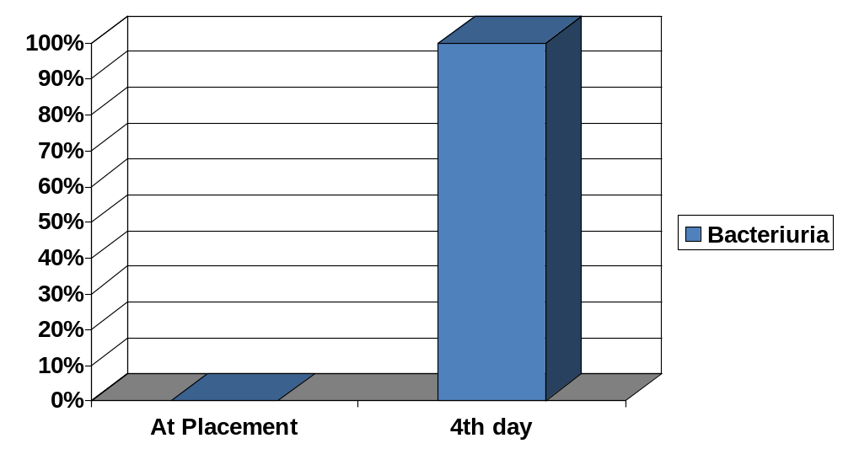
Catheter-Associated Bacteriuria
(Open Drainage System)
Notes:
Promptly Remove Unnecessary Urinary Catheters
This graph demonstrates how quickly a urinary tract infections begins in a patient with an open drainage system.
After just 4 days 100% of the patients will have bacteria in their urine.
Fortunately, we no longer use open systems.

Slide 14
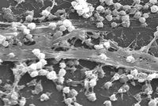
Biofilm: Extracellular Polymers
(Donlan, CID 2001; 33:1387–92, Liedl, Curr Opinion Urol 2001;11: 75-9)
Organisms attach to and grow on a surface and produce extracellular polymers
Intraluminal ascent (48hours) of bacteria faster than extraluminal (72-168 hours)
Most catheters used >1 week have biofilms
Extraluminal more important in women
Staphylococcus aureus biofilm on an indwelling catheter.
CDC Public Health Image Library
Notes:
Promptly Remove Unnecessary Urinary Catheters

Slide 15
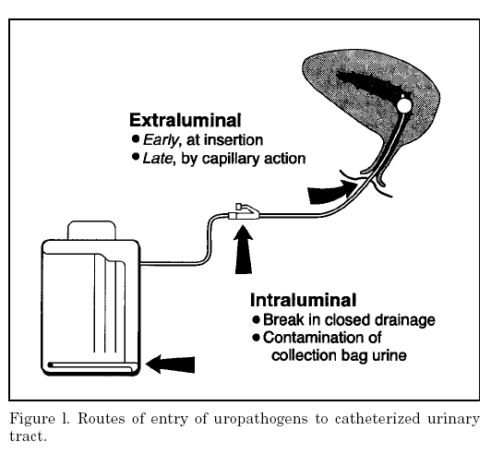
Usually females
Usually males
Maki, Emerg Infect Dis 2001; 7: 1-6

Slide 16
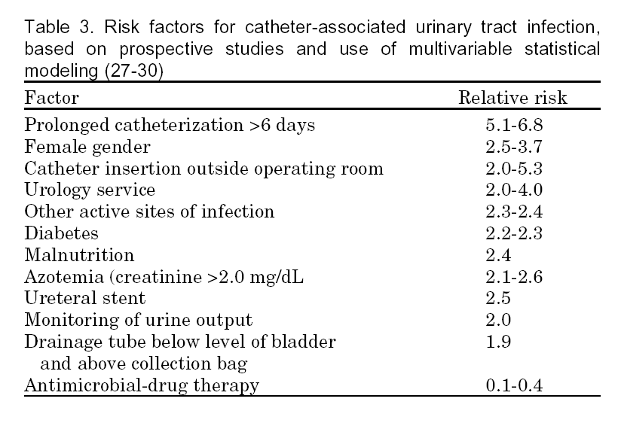
Maki, Emerg Infect Dis 2001; 7: 1-6

Slide 17
Bacteriologic Monitoring
Not recommended for asymptomatic patients.
Only culture the urine if the patient has symptoms of an UTI such as fever, chills, and abdominal pain
Cloudy urine ≠infection
Sediment in urine ≠infection
Notes:
Promptly Remove Unnecessary Urinary Catheters

Slide 18
Asymptomatic Bacteriuria
No benefit from treatment
Increased risk of resistance and C. difficile disease with treating asymptomatic bacteriuria
Pyuria does not equate infection when catheter present
Avoid urine cultures unless patient is symptomatic or if it is a part of sepsis workup in a catheterized patient

Slide 19
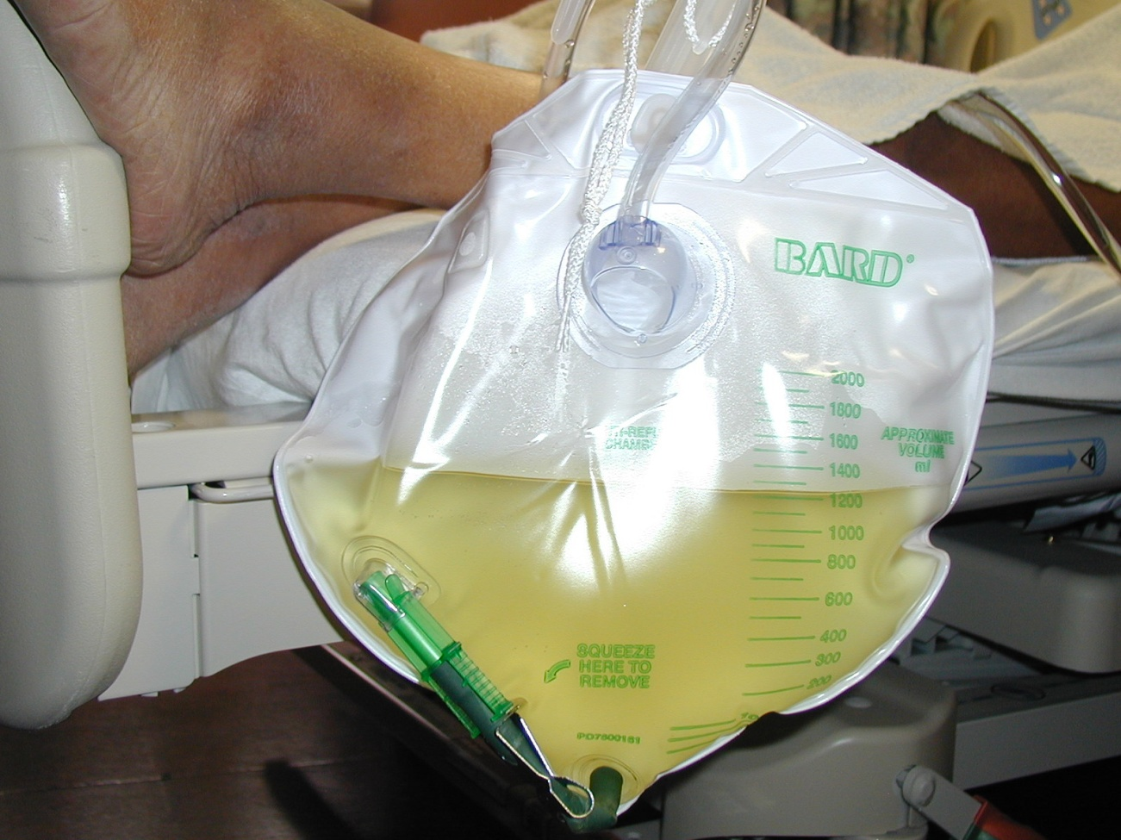
Clear Urine
Keep the urinary catheter bag lower than the patient!!!

Slide 20
Acceptable Indications for
Urinary Catheter Placement
Acute urinary retention or obstruction
Perioperative use in selected surgeries
Assist healing of perineal and sacral wounds in incontinent patients
Hospice/comfort/ palliative care
Required immobilization for trauma or surgery
Chronic indwelling on admission

Slide 21
Acute urinary retention or obstruction
Outflow obstruction: examples include prostatic hypertrophy with obstruction, urethral obstruction related to severe anasarca, urinary blood clots with obstruction
Acute urinary retention: this may be medication induced, medical (neurogenic bladder) or trauma to spinal cord.

Slide 22
Perioperative use in selected surgeries
Urologic surgery or other surgery on contiguous structures of the genitourinary tract
Anticipated prolonged duration of surgery, large volume infusions during surgery, or need for intraoperative urinary output monitoring
Spinal or epidural anesthesia may lead to urinary retention; prompt discontinuation of this type of anesthesia should prevent need for urinary catheter placement

Slide 23
Assist healing of perineal and sacral wounds in incontinent patients
This is a relative indication when there is concern that incontinence is leading to worsening skin integrity in areas where there is skin breakdown

Slide 24
Hospice/ comfort care/ palliative care
This is a relative indication. In end-of-life situations, it is reasonable to accommodate the patient’s wishes on what provides them with the best comfort

Slide 25
Required Immobilization for
Trauma or Surgery
This includes:
unstable thoracic or lumbar spine
multiple traumatic injuries such as pelvic fractures
Acute hip fracture is risk for dislocation

Slide 26
Chronic Indwelling Urinary Catheter upon Admission
Patients from home or extended care facility with a chronic urinary catheter

Slide 27
Unacceptable Reasons for Placement
Urine output monitoring OUTSIDE intensive care
Incontinence
Morbid obesity
Immobility
Confusion or dementia
Patient request

Slide 28
Urine Output Monitoring OUTSIDE Intensive Care
This includes:
  Close urinary output monitoring by nephrology in patients with renal failure
  Monitoring of urine output in patients with congestive heart failure on diuretics
Potential solutions:
Use urinals for men and hats for women (to monitor output)
Accurate daily weights.
Notes:
Promptly Remove Unnecessary Urinary Catheters

Slide 29
Urine Output Monitoring OUTSIDE Intensive Care
For patients with congestive heart failure, consider involving the patient
Provide patients with information regarding how to document their output and daily weights (consider pamphlets)
This will also help the patient learn to accurately measure their output.

Slide 30
Incontinence
Incontinence should not be a reason for urinary catheter placement. Patients admitted from home or from extended care facilities with incontinence managed their incontinence without problems prior to admission. Mechanisms to keep the skin intact need to be in place and avoid urinary catheter placement in that population.
Notes:
Promptly Remove Unnecessary Urinary Catheters

Slide 31
Incontinence: Potential Solutions
Use Skin Barrier Creams for protection
Start Toilet Training:
  Offer use of bedpan or assist patient up to commode regularly
Evaluate for any wet bed linen and change if wet at the time patient is being turned in bed
Notes:
Promptly Remove Unnecessary Urinary Catheters

Slide 32
Patients Transferred from
Intensive Care to Floor
The intensive care is an area where high prevalence of urinary catheter utilization is present.
Evaluating those who are transferred to non-intensive care units for need of urinary catheter and discontinuation of those not needed may significantly reduce unnecessary utilization
Notes:
Promptly Remove Unnecessary Urinary Catheters

Slide 33
Morbid Obesity and Immobility
Morbid obesity should not be a trigger for urinary catheter placement. Patients that are morbidly obese have functioned without a urinary catheter prior to admission. The association of immobility and morbid obesity may lead to more inappropriate catheter placement. This may result in more immobility with the urinary catheter being a “one point restraint”
Notes:
Promptly Remove Unnecessary Urinary Catheters

Slide 34
Immobility: Potential Solutions
Start toilet training every 2 hours
Offer bedpan, urinal or assist patient out of bed
Of 145 hospitalized patients with a high risk for pressure ulcers, urinary catheter presence was associated with 1.8 times risk of pressure ulcer compared to those without urinary catheter (p=0.03). The most significant association was between urinary catheter catheter use and stage 2 pressure ulcer.
Notes:
Promptly Remove Unnecessary Urinary Catheters

Slide 35
Confusion or Dementia
Patients with confusion or dementia should not have a urinary catheter placed unless there is an indication for placement
Notes:
Promptly Remove Unnecessary Urinary Catheters

Slide 36
The Very Elderly Patients
Disproportionate use inappropriately in the very elderly.
It may be a marker of immobility, incontinence, and dementia?

Slide 37
Patient Request
Although healthcare workers may report that patients want the urinary catheter in, this is infrequently documented. The only exception is in patients that are end of life or palliative care.
Patient’s Convenience:
  Example: patient on diuretics and does not want to move out of bed multiple times
  Education is key! Provide reasons to patient of increased risk of urinary catheter : urine infection, skin breakdown, deep venous thrombosis and/or pneumonia due to immobility

Slide 38
Increased Work Load for
Healthcare Workers (HCW)
Increased acuity of patients or reduction of the nurse to patient ratio
e.g., patient is incontinent and immobile and requires multiple changes of sheets
Potential solution: link it to other initiatives (eg. pressure ulcer prevention requires frequent repositioning of patients), evaluate the nurse to patient ratio, shift resources to support the HCW that has more responsibilities

Slide 39
Obtaining Urinary Specimens
Discourage urinary catheter use for specimen collection
Consider straight catheterization if the patient is unable to void or is incontinent
Notes:
Promptly Remove Unnecessary Urinary Catheters
Read slide as is…..

Slide 40
Reminder for Appropriate Urinary Catheter Use
Avoid urinary catheter use if not indicated
Try to discontinue the catheter promptly when not needed
The longer the catheter is present, the higher the risk of infection!
The urinary drainage system should always remain a closed system
Notes:
Promptly Remove Unnecessary Urinary Catheters

Slide 41
Additional Tools to Reduce Inappropriate Urinary Catheter Use
Bladder scanner: if available, may check if patient had urinary retention. This may avoid urinary catheter insertion or straight catheterization
Condom catheters: may be used for men with incontinence with risk of skin breakdown (e.g., pressure ulcers), or for accurate urine output monitoring in intensive care. Condom catheters cannot be used if the patient has urinary retention

Slide 42
Insertion and Maintenance of Urinary Catheters
Hand hygiene before and after placement
Aseptic technique and use of sterile equipment
Use sterile gloves, drape, an antiseptic solution for periurethral cleaning, and a single packet of lubricant for insertion.
Notes:
Promptly Remove Unnecessary Urinary Catheters

Slide 43
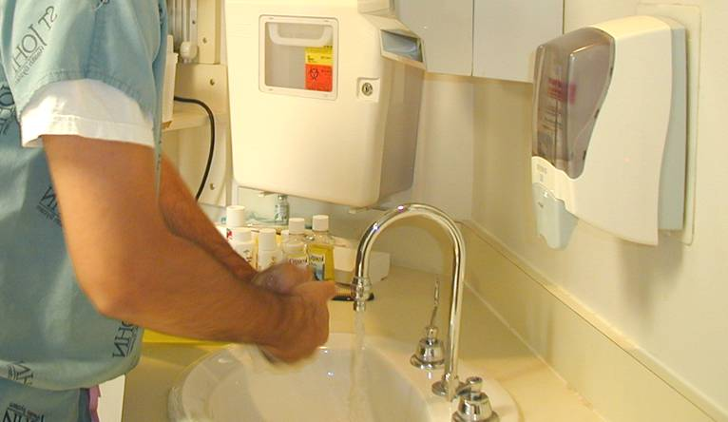
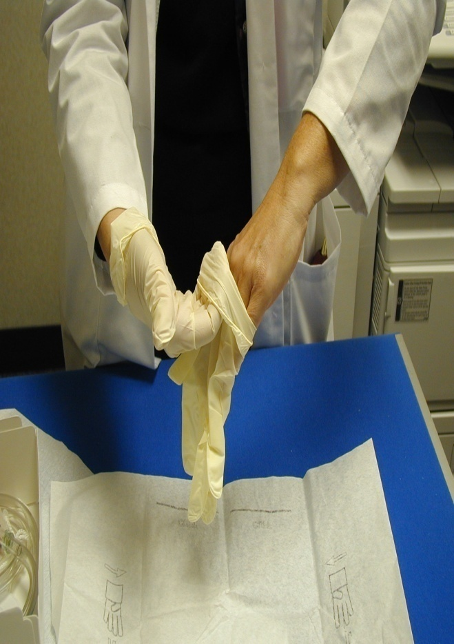
Maintain Sterile Technique
Good hand hygiene
before and after
procedure.
Don sterile gloves before procedure.

Slide 44
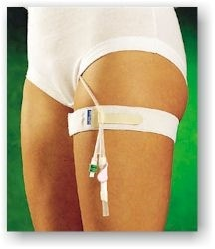
Placement of Urinary Catheter
Use smallest catheter size effective for patient (14 or 16F)
Catheters should be properly secured to prevent movement and urethral traction
Notes:
Promptly Remove Unnecessary Urinary Catheters

Slide 45
Maintenance of Urinary Catheters
If there is a break in sterile technique, or leak from the closed system, replace the urinary catheter and the drainage system
Make sure the urinary flow is not obstructed
  No kinks of catheter
  The urinary bag should always be lower than the bladder
  Regular emptying of urinary bag
Notes:
Promptly Remove Unnecessary Urinary Catheters

Slide 46
Maintenance of Urinary Catheters
Do not change urinary systems routinely
Consider changing urinary system if:
  Infection
  Obstruction
  Break or leak of the closed system
Notes:
Promptly Remove Unnecessary Urinary Catheters

Slide 47
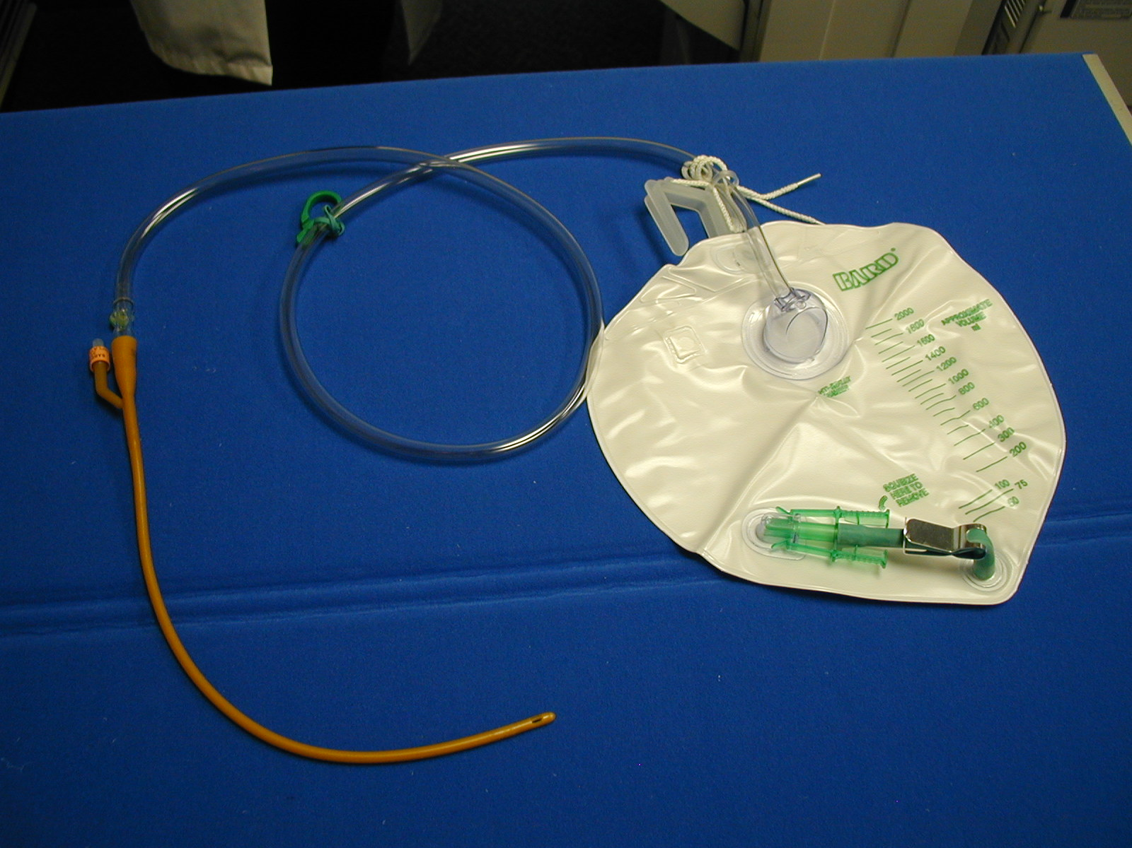

Potential Site for Contamination
Sterile technique must be used when inserting the catheter.
Do not use aggressive cleaning once urinary catheter is in place.
Notes:
Promptly Remove Unnecessary Urinary Catheters

Slide 48

Potential Site for Contamination
Sampling Port: Disinfect port before sampling urine. Also, check site for possible disconnection of catheter from drainage bag.
Notes:
Promptly Remove Unnecessary Urinary Catheters

Slide 49
Potential Site for Contamination
System may become an open system if outlet is left hanging or is unclamped
Notes:
Promptly Remove Unnecessary Urinary Catheters

Slide 50
Maintenance of Urinary Catheter: Irrigation
Avoid irrigation unless necessary (obstruction of catheter)
Catheter tubing junction should be disinfected before irrigation
Use the sampling port to relieve the obstruction
Do not disconnect the closed system unless you cannot use sampling port

Slide 51
Periurethral or Meatal Care
Washing meatus with povidone-iodine or soap is not associated with lower infection risk.
Aggressive cleaning may be associated with increased infection!
Routine hygiene during bathing is appropriate.
Notes:
Promptly Remove Unnecessary Urinary Catheters

Slide 52
What Needs to be Done
Both nurses and physicians should evaluate the indications for urinary catheter utilization.
Physicians should promptly discontinue catheters that are no longer needed.
Nurses evaluating catheters and finding no indication should contact physician to promptly discontinue catheter.

Slide 53
Urinary Catheter Use
Place Only When Necessary
Promptly Remove When Not Necessary

Slide 54
This completes the
“Appropriate Urinary Catheter Use and Management” module.
(Optional Evaluation Test)

